Slide 1
Career Mobility Program
Agile Team Processes & Guidelines
Last Update: May 2021

Slide 2
Table of Content
Overall Process and Plan
Team workflow
Sprints & Release cycle
Phase 2 Release Plan
Backlog Management
Managing Sprint
SCRUM Ceremonies
Backlog Refinement Process
User Story Refinement Guidelines
Story Refinement Meetings – BA Process
Sprint Planning
Sprint Execution
Story Showcase
Sprint Retrospective
Sprint Closing
KPIs Tracked
ADO Board Workflow
Standard QA Processes
The Regression Week
UAT Lifecycle
Product Backlog Item Standards

Slide 3
Table of Content Contd..
Feature Life Cycle
Process of breaking down Feature into User Stories
Features to User Story Example
How to write Technical Feature\User story
How to write great user stories
User Story Example
Example of a Bug
User story sizing guidelines
User Story Life Cycle
Bug Life cycle & Bug reason
Bug Severity Classification
ADO Guidelines
Checklist for ADO usage
How to use tags in ADO
ADO Backlog Relationship
ADO Backlog Organization
Team Backlog
Team Sprint Task Board in ADO
ADO features
Roles and Responsibilities
Product Owner and BA Role Defined

Slide 4
Table of Content Contd ..
Career Mobility Program – Organization
Coforge Team Members: Roles and Responsibilities
Scrum Team’s Learnings from Phase 1
Translation Management Process
Bug Life Cycle

Slide 5
Overall Process and Plan
1

Slide 6

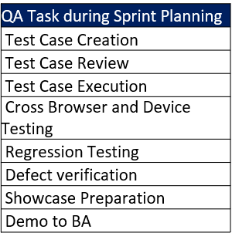
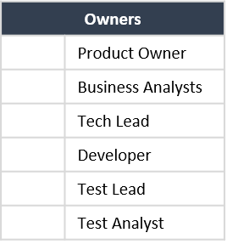

Team workflow
New Requirements
Changes to the existing User Stories
Business Feedback
Enhancements (Change Requests)
Production Issues (Problem Tickets)
Product
Backlog (Ready for Refinement)
SI Testing
UAT
PBIs
Refinement Call
Latest
Version
Business
Sign-off
Requirements
Sprint
Production
Releases
Sprint Planning (QA Task created)
Test Cases/ Automation
scripts
Review Test cases
and scripts
Ready Test
bucket
& Test Lab
Product Backlog
(Committed)
White Boarding
Sprint Execution
Business Feedback/ Change Requests – New PBI in same sprint
Defect – Dev to fix
Defects found in QA
Develop
Code Check in to
QA Environment
Functional Test on QA
No C/H/M defect
PBI DEMO
(Ready for Showcase)
Showcase Done
Iterate
Acceptance Test on local
dev environment
No C/H/M defect
QA Signoff on
UAT env
QA Signoff
on QA env
Code Check in to
UAT env.
Sanity Test
On UAT env.
BA testing
on UAT env
RCA for UAT Defects.

Slide 7





Sprints & Release cycle
Key Information
Release to Production: Every 7 week
Total elapse duration: 7 weeks
4 weeks development: 2 Sprints @ 2 weeks/sprint weeks)
1 Week Regression
1 week UAT
1 week Release Preparation
Minimum Backlog readiness Planned with ready and prioritized backlogs: next 2 sprints or 90 SP per team
Minimum To-Do: Next Release or 90 SP
Total Scrum Capacity (across all applications): 90 Story Points (45 per sprint)
W1
W2
W3
W4
W5
W6
W7
W8
W9
W10
W11
W12
W13
Backlog Refinement
1 week
1 week
1 week
1 week
Sprint Scope Frozen
Sprint Planning
Stories Committed
Sprint Scope Frozen
Sprint Planning
Stories Committed
Sprint Scope Frozen
Sprint Planning
Stories Committed
Sprint Scope Frozen
Sprint Planning
Stories Committed
Sprint 1
Sprint 2
Regression
Sprint 3
Sprint 4
Regression
Showcase
Showcase
Showcase
Showcase
Showcase
Showcase
Showcase
Showcase
Retrospective
Retrospective
Signed
off by BA
Code Freeze period
For Release 1
Signed
off by BA
Signed
off by BA
Signed
off by BA
Code Freeze period
For Release 2
UAT
Release week
UAT
Release week
Go Live
All check ins to be deployed for Release 1
Selective check in to be deployed for Release 1
No check ins for Release 1
Go Live

Slide 8
Phase 2 Release Plan
Release 0 Start
Release 0 End
Dev Start
Dev End

Slide 9
Backlog Management
Feature Change control in places to manage scope; features going in/out of scope must be approved
re delivery timeline decision must be updated in collaboration with Product Owner, IT Business Partner, and technology workstream leads.
ADO Updates for Scope and Timeline changes can only be made by CMP Project Manager (Jacoba)
Product Owner & BA Feature Assignments v3

Slide 10
Managing Sprint
2

Slide 11
SCRUM Ceremonies
Scrum is an agile process that allows us to focus on delivering the highest business value in the shortest time ( 2 weeks cadence). As per scrum process following ceremonies are being executed .
Sprint planning
Daily scrum meeting
Refinement
Sprint review
Sprint retrospective
Sprint Planning
Daily Scrum Meeting
Demo / Showcase
Retrospective
To refine user stories to the granular level so that same can be assigned to developer for development and also story point them .
To decide how to achieve current sprint goal .
Showcase developed user story (ies) within the specified sprint to required audience
To retrospect various aspects as how can we do better in next sprints
Backlog Refinement
To check daily progress , blockers or Impediments if any
Scrum Of Scrums
Inter team discussions to understands dependencies and impacts if any .

Slide 12
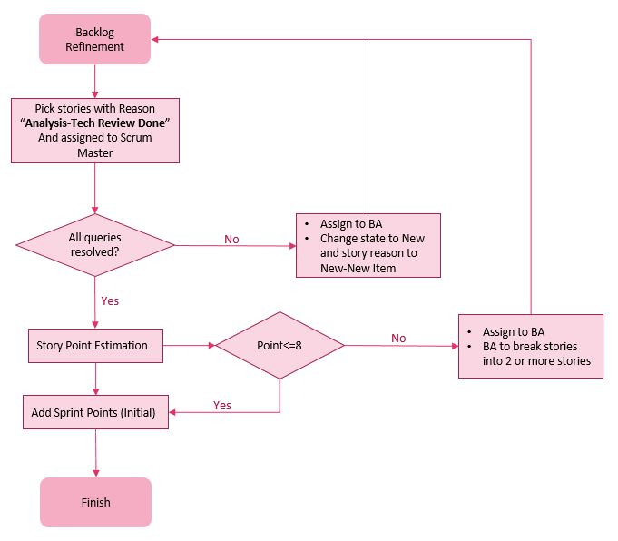
Backlog Refinement Process
Owner – Business Analysts
Pre-requisites
Stories with State marked as “Analysis” & Story Reason as “Analysis-Rdy for Tech Review ” by BA
Stories with State marked as “Analysis” & Story Reason as “Analysis-Tech Review Done” by TA and assigned to BA
Scrum team has reviewed the feature/stories briefly and prepared their queries
Purpose
Scrum team to discuss stories that are ready for refinement with BA, clarify all open questions and provide story points so that the same can be used for planning.
Activities
Business
Functional Story – defined, detailed and clarified
Acceptance Criterions, scenarios defined
Business Analysts
Technical Story – Notes, Non-functional part and design inputs
Story pointing with scrum team. Any Story >8 story points broken further.
Scrum Manager
Story is prioritized and assigned to SM & added to planned queue in ADO scrum team backlog.
In case of any unanswered queries, PBI is updated with all the questions, and State is marked as New & Story Reason as and the PBI gets assigned to BAs.
Frequency
2 times a week (minimum) to continuous daily targets
Attendees
Business, BA, Agreed Scrum team members

Slide 13
User Story Refinement Guidelines
# | Guidelines for picking PBIs for Refinement(PBIs Ready For Refinement)
1 | All acceptance criteria clearly defined by BA
2 | Story reviewed by Greg Crease for Data Security and Pieter De Vilder for Data privacy. Requirements added accordingly.
3 | UI mock-ups attached where applicable.
4 | Technical review completed/Dev Notes added.
5 | Business rules & field validations clearly defined(e.g. pagination clarity, sorting order of dropdown list etc.)
# | Guidelines for the Refinement call
1 | Scrum team should ensure that estimation of any functional PBI should not be more than 8 story points and in case it is exceeding 8 SP's then that PBI should be broken into smaller ones.
2 | A PBI should be broken into more PBIs in order to logically segregate them(e.g., create & view functionality)
# | Guidelines for committing a user story
1 | PBI should be picked up for development only once all the third parties' dependencies are met.
2 | Stories requiring Create, Read, Update & Delete(CRUD) operations for a functionality shall not be committed as part of a single sprint. The create, view work should be picked up in one sprint and update, delete work post that in another sprint.
Refinement done 2 Sprints in advance
Regression Week
Backlog refined for Sprint 6
Backlog refined for Sprint 3
Backlog refined for Sprint 4
Backlog refined for Sprint 5
Guidelines for writing a Great user Story
1 | Please refer to slide 29

Slide 14
Story Refinement Meetings – BA Process
Pre-refinement :
Mock-ups should be attached to all stories where required
Acceptance criteria should be clearly defined
Accessibility NFR's should be included in the description.
During Refinement :
Product Manager and BA must be present during the refinement as per the ownership of the feature being refined
All functional queries should be answered by Product Manager / BA and technical queries to be answered by design team within the call itself. If further discussion is required then those has to be clarified within 24 hours.
Sprint planning
Daily scrum meeting
Refinement
Sprint review
Sprint retrospective
BA/PM – Aha!
Tech Reviewer - DevOps
Set story reason to RDY for Tech Review, no assignee
Feature – Detailed
Needs a full description of the feature
Prioritized against other current features
Feature – RDY for Tech Review
Create any supporting Tech Features/Stories, Database models, naming conventions, NFRs
Requirement
Full acceptance criteria
Wireframe mocks/responsive layouts
Prioritized inside the feature
User Story
Describe Implementation
Set dependencies
Create any additional supporting user stories
Set story reason to Tech Review Done, Assign to BA

Slide 15
Backlog Refinement Cont.
BA/PM – Aha!
Tech Reviewer - DevOps
Set story reason to RDY for Tech Review, no assignee
Feature – Detailed
Needs a full description of the feature
Prioritized against other current features
Feature – RDY for Tech Review
Create any supporting Tech Features/Stories, Database models, naming conventions, NFRs
Requirement
Full acceptance criteria
Wireframe mocks/responsive layouts
Prioritized inside the feature
User Story
Describe Implementation
Set dependencies
Create any additional supporting user stories
Set story reason to Tech Review Done, Assign to BA

Slide 16
Sprint Planning
Pre-requisites
Stories assigned to SM and part of the current sprint in backlog
Purpose
Team to create tasks and associated hours. Time estimation should not exceed 6 hours per task as it is the maximum time allowed to complete any task
Team to commit the stories for the sprint
Outcome
Stories committed for the sprint
Stories assigned to Developer
Stories status changed to “Committed”
Frequency
A week before the start of Sprint
Attendees
Scrum team members
Sample Tasks template
QA | Test Case Creation QA | Test Case Review QA | Test Case Execution QA | Cross Browser and Device Testing QA | Regression Testing QA | Defect verification QA | Showcase Preparation QA | Demo to BA
DEV | Design / Dev notes updates / Code walkthrough DEV | Translation Creation for Hours in DB DEV | Add Element Directive for Hours And Minutes Display DEV | Get Duration in minutes from database and convert it into hours and minutes and update UI DEV | Code Review DEV | Bug Fixing DEV | Unit Test Cases Creation DEV | Unit Test Cases Execution

Slide 17
Sprint Execution
Sprint Execution
Design Review /Whiteboard session
Pre-requisites
Story State to be "Active” and Story reason to be “Active-Committed”
Stories have been assigned to respective Developers and QA .
Sprint planning Done (Tasks and effort added)
Purpose/Process
Development and QA by Scrum team
Queries with BA: During execution a user story should never be assigned to BA/Architect and accountability remains with the developer
Effort Logging: Each team member is required to log his/her effort against assigned tasks daily
Any task should not be of more than 6 hrs.
Outcome
Story ready for Showcase to BA , BP , PM , QA Manager etc.
Coding Done
QA-Test Cases Done
UTC Done
QA-Test Cases Review Done
Code Review Done
Yes
Local QA
Passed?
No
Log Defects
Yes
Code Check in
Fix Defects
Test execution in QA environment
Blocker defects ?
Yes
Log Defects
No
Fix Defects
Ready for Showcase

Slide 18
Story Showcase
Pre-requisites
Demo can be done with High/Medium/Low defects in story provided there is no critical defect .
All Dev& QA tasks should be closed .
Purpose/Process
Demo stories to required audience for their feedback
“Demo done” tag to be added to PBI’s only once QA signoff is received in QA/UAT env.
Outcome
Story is ready for UAT/Closure .
Frequency
1 per week
Attendees
BA, BP, PM , QA Manager and Scrum team members
Sprint Story dev completed
QA Sign-off Received ?
Yes
Ready for Demo
No
Any Critical defect ?
Yes
Defect fixing cycle
No
To progress with Demo
Demo
done successfully?
No
Feedback / defects ?
Feedbacks
Change Register
Yes
Defects
Demo Completed
Defect fixing cycle

Slide 19



Sprint Retrospective
Sprint Retrospective is done at the end of each Sprint
Week 1 | Week 2 | Week 3 | Week 4 | Week 5 | Week 6
Sprint 1 |  | Sprint 2 |  | M/R | UAT
Merge & Rregression
Sprint 1 Retrospective
Sprint 2 Retrospective
Release
Agenda for Retrospective
What went well
What did not go well
What can we improve

Slide 20
Sprint Closing
Carried over issues from Sprints to get categorized as per below
Low Priority bugs –will be added to the Unplanned Work user story in appropriate Sprint
Requirement bugs –will be assigned to BA, who will have a corresponding User Story created which will be prioritized for future Sprints post which Dev team will mark the defect as removed. Root cause of the defect will be Inadequate Requirement. Such stories to be tagged with “Additional Scope”
Technical Debt –couple of user stories need more investigation and a proper solution technical implementation which will be dealt under a Technical Debt user story post which Dev team will mark the defect as removed.
Translation Process (if applicable)
Coforge developers to fill in all the resource keys on the relevant tab on Teams channel | Complete on last Friday of the Sprint
Business team to get the translations done | In Regression week
Coforge developers to create the script | In UAT week
Coforge developers to add the script to TEAM’s location | In Release week
Coforge developers to give the script for execution | On Friday of UAT week
Carried over stories/tasks discussed with BA and moved to next Sprint

Slide 21
KPIs Tracked
Code Coverage
Release RAG Status
Dev Readiness RAG Status
UAT Defects Leakage
Test Automation Coverage
Sprint Burndown

Slide 22
Code Coverage
What is Code Coverage
A software testing metric that determines the number of lines of code that is successfully validated under a test procedure, which in turn, helps in analyzing how comprehensively a software is verified.
Code Coverage Percentage = (Number of lines of code executed by a testing algorithm/Total number of lines of code in a system component) * 100
Benefit of Tracking and Measuring
A high code coverage points to a well-written and testable code
Developers are more likely to write/improve a unit test if they notice the coverage drop
High code coverage leads to confidence in code which improves the quality of the software
Faster time to market
Frequency of Measuring and Baseline
Code coverage will be measured at the completion of a Sprint
The baseline is 80% code coverage

Slide 23
Release RAG Status
What is Release RAG Status
An indicator to assess the health of current release
Release RAG status will depend on the following Parameters
Availability of Environment (Yes/No)
Closure of all High Priority User Stories (Yes/No)
Resolution of inter-team dependencies (Yes/No)
Availability of Resource key translation (Yes/No)
QA Signoff (Yes/No)
Product Owner Signoff (Yes/No)
UAT Signoff by BA (Yes/No)
RAG Criteria
All Yes
1-3 Nos
<3 Nos
Benefit of Tracking and Measuring
It will help the team in taking any corrective steps in advance that are required to make the release successful within the defined timelines
Frequency of Measuring and Baseline
Release RAG status will be measured before a release
The baseline is to have a Green RAG status

Slide 24
Dev Readiness RAG Status - WIP
What is Dev Readiness RAG Status
An indicator to assess the health of development readiness of
upcoming 2 sprints .
Dev Readiness RAG status will purely depend on whether team has around
90 SPs of refined work ready for next 2 sprints .
if not , due to any of the following reasons
Any 3rd party dependencies
Any technical dependencies
Any business dependencies
then these must be identified and resolved at the earliest .
RAG Criteria
90%- 100 % SPs
70%-89 %SPs
<70% SPs
Benefit of Tracking and Measuring
Having this process in place ensures that teams have enough work ready for upcoming sprints which enables seamless & quality development life cycle.
Frequency of Measuring and Baseline
Dev Readiness RAG status will be measured at any given point of time or daily basis
Base line is to have 90 SPs of refined work ready for next 2 sprints .

Slide 25
UAT Defects Leakage
What is UAT Defects Leakage
UAT Defect Leakage is used to identify the efficiency of the QE testing,
it gives how many defects are missed/slipped in lower environment
and caught by UAT testers during UAT.
RAG Criteria
<= 5%
4% - 10 %
> 10 %
Benefit of Tracking and Measuring
UAT DLR is a key Metric to measure the efficiency of Quality Engineering testing. DLR should be as low as possible to achieve good quality. It gives Test cases coverage quality as well. Test case coverage is inversely proportional to DLR.
Frequency of Measuring and Baseline
UAT defects leakage should be measured after very UAT cycle done by UAT testers. UAT DLR = (# of defect found in UAT/ Total Number of defects in that cycle.) *100

Slide 26
Test Automation Coverage
What is Test Automation Coverage
Test coverage is one of the measurements of test quality that tells us how much of the application under test has been tested. Test Automation Coverage is the percentage of test cases automated out of total test bucket for a functionality under test.
Benefit of Tracking and Measuring
Test automation coverage is an important metric to measure the percentage of automation done in a project and how much effort saving done by this. Which can be used by manual test team for testing complex end to end scenarios, integration testing and interface testing.
Frequency of Measuring and Baseline
Test Automation Coverage should be measured after every sprint and should be baselined post every regression cycle.
Percentage coverage ​ | RAG status​
Greater than or equal to 60%
40% to 60%​
Less than 40%

Slide 27
Burndown Chart - WIP

Slide 28
ADO Board Workflow

Slide 29
Standard QA Processes
3

Slide 30
The Regression Week
After two full sprints, a regression week is planned. During this period, all new code which is developed and deployed in UAT environment since last regression are tested again.
QA team is required to re-execute previously executed test cases in UAT environment in order to verify the impact of change. This is done to verify that a code change in the software does not impact the existing functionality of the product. Additionally, they re-verify critical defects from previous 2 sprints
Retrospective meetings
Root Cause Analysis of the defects reported in UAT
Actual Story Points for completed stories calculated
Regression Testing
Great User Experience
Early detection of Bugs
Confidence in build
Early Rollback if needed
Improved Quality

Slide 31
UAT Lifecycle

Slide 32
Product Backlog Item Standards
4

Slide 33
Feature Decomposition and Workflow
Guidelines and overall workflow here

Slide 34
Feature Life Cycle:
Steps​ | Owner​ | State​ | Assigned to​ | Efforts | Priority | Comments
New Feature is created with a high-level summary of expectations & Basic Requirements along with base Area | BP/BA/Technical Architect | New​ | BP/BA/Technical Architect​ | ​ | ​ | Suggest feature organization, existing common features​ -Organize into Epic​ -Set Feature predecessors​ -Set Area Path
Feature is made ready for high Level Estimation | Technical Architect​ | Ready To Size​ | BA/Technical Architect | <Value Added>​
Feature t-shirt sizing done | Technical Architect​ | Sized
Feature is ready to be broken into stories | BA​ | Product Backlog​ | BA | <Value Retained>​ | <Value Added>
Feature assignment to an owner | BA/Tech Architect | Ready To Assign | BA/Tech Architect | <Value Retained> | <Value Retained> | -Set Feature predecessors​ & Successors -Describe Implementation​ -Set dependencies
Feature ready to be broken in stories | BA/Tech Architect | Ready To Decomp | BA/Tech Architect | <Value Retained> | <Value Retained> | -Create supporting user stories
Feature development work in progress | BA/Tech Architect | In Progress | BA/Tech Architect | <Value Retained> | <Value Retained> | -Stories development of user stories are in progress.
Feature ready for release​ | BA/Tech Architect | Released​ | BA/Tech Architect | <Value Retained>​ | <Value Retained>​
Feature to be removed | BA/Tech Architect | Removed​ | No Assignee | <Value Retained>​ | <Value Retained>​ | Feature is removed if either it is deprioritized or requirement is no more there.

Slide 35
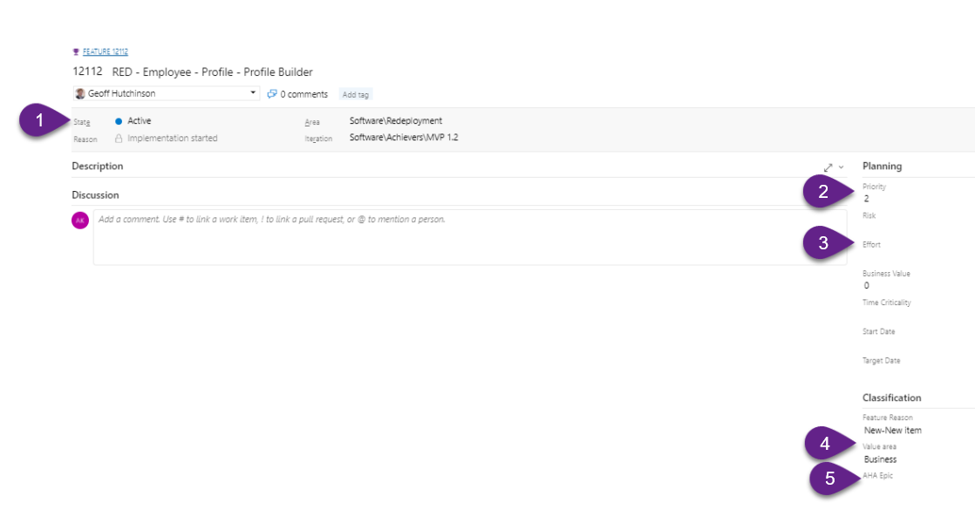
Feature Life Cycle Cont.
Aha Epic: New Custom field in ADO at Feature level and call it “AHA Epic”. When AHA and ADO synchronize, the epic value from AHA gets attached with this custom field in ADO
Value Area: New Custom field in ADO at Feature level , This field is used to identify if the work is Architectural or Technical. All that come over from Aha are already set to "Business“
Effort: New custom Field added in AHA! for adding T-shirt sizing for Feature. This value will be sync back & forth to ADO
Priority: New Custom Field has been added in AHA!. We need to setup Priority between (1-4). This will help to prioritize the features. This value will be sync back to ADO

Slide 36
Process of breaking down Feature into User Stories
Many small stories add up to a releasable feature, but each story should also be releasable by itself and should easily fit into a single Sprint.
Split story in case a simple part of the story gives most value and enhance other portions later
A Feature should be broken down into enough User Stories so that that we can even afford to de-prioritize one if needed.
Stories should be clear to developers, simple to complete, easy to test, and gain internal acceptance on
Stories/Acceptance Criteria should capture intent and desired outcomes, leaving the actual development instructions to the experts.
Create separate user stories for each CRUD operation (CREATE, READ, UPDATE, DELETE)
Write Enabler User Stories like UX Stories, NFR Stories and Interface Stories
Technical and Data Model Stories to be discussed and written by Technical team
Supporting documents like Zeplin/Wireframes/UI mockups/Process flow charts should be provided with the User Story

Slide 37
Features to User Story Example

Slide 38
How to write Technical Feature\User story
Following points to be considered while writing technical feature or User Story
Define the Business context i.e. who and why will use this technical component
Define and design the Complete data requirement
Clearly definition of Success and Error response
Error code details
Data and business validation details
Exception handling and Logging
Acceptance criteria
Make sure all technical components are working as expected for example API endpoint request and response should be as defined in user story
UTC should be running successfully
Brief documentation of technical component e.g. Swagger document for API, Data modelling etc.

Slide 39
How to write great user stories
Our Best Practices
1. User story format:
As a <<User Role>>, I want <<action>>, so that <<a value>>
Acceptance Criteria 1
Acceptance Criteria 2
2. Avoid more than 1 action per story
3. Stories should state the functional scenarios and avoid Acceptance criteria like “It should behave in the same way as in existing application”
4. Non-Functional stories like number of records expected on page, number of candidates a colleague have etc. to be created
5. UI stories
UI elements/mock-ups attached
Field validations rules added
Sorting rules added
Acceptance Criteria
A list of conditions and outcomes that defines the business rules supporting the desired solution/system behavior. Covering all the majority of positive, alternate or exception conditions that system may encounter in the real world. Each acceptance criteria should include:
Given… the pre-condition or scenario that user is in
When… the logic condition or triggering event
Then… the expected outcome based on the pre-condition and logic
Our stories are based on INVEST Principle
Independent | Can be released without dependencies
Negotiable | Ready for discussion and can be adapted based on team input
Valuable | Delivers value to end user
Estimable | Dev team can estimate its relative complexity
Small | As small as possible while still providing real user value
Testable | Contains the acceptance criteria that guides testing

Slide 40
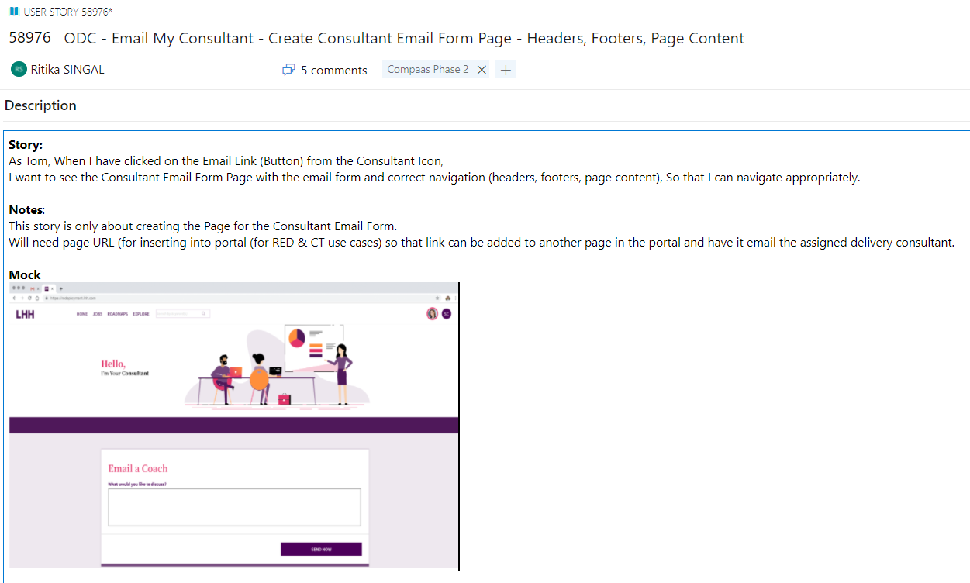
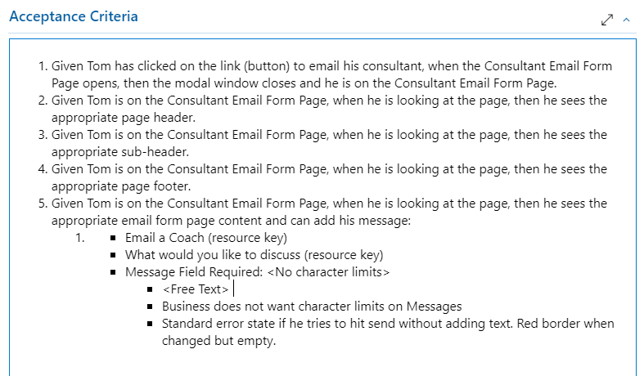
User Story Example

Slide 41
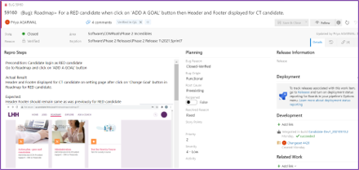
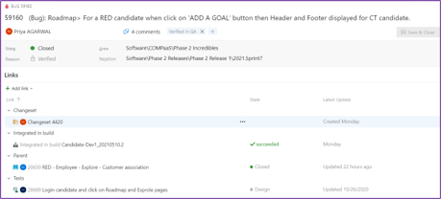
Example of a Bug
Important fields in a bug:​
Title – “Bug” keyword in title shows issue caught in QA environment, “Defect” keyword in title shows issue caught in UAT​
Description with screenshots – Bug should have proper “Steps to preproduce” and self-explanatory screenshots.
Bug Reason – It matches current action taken on bug with its current state. Details can be seen in appendix.​
Bug State – It explains current state and owner of the bug.​
Bug Origin – It explains the bug origin in terms of environment or functional or a regression bug.​
Root Cause – Mainly used by developer to state the cause behind the bug.​
Severity – Gives the impact of a bug on a functional flow/ application.​
Assigned To – It explains the owner of the defect at particular State and bug reason.​
Linking with Parent (User Story) and Test Case – Helps in generating traceability of requirement.
Area and Iteration Path – Gives the details of sprint bug was detected for any specific scrum team.​

Slide 42
User story sizing guidelines
Story Points is an approximation technique to gauge how hard a story (PBI) is. It is mix of complexity, Unknown and effort. ‘Story pointing’ is relative estimation than traditional time-based estimation. Story points allow team members with different skill levels to communicate about and agree on an estimate.
Story Point Value | Time Bucket
1 | 3-6 hours
2 | 6-13 hours
3 | 13-20 hours
5 | 20-25 hours
8 | 25-55 hours
13 | 55-85 hours
21 | 85-115 hours

Slide 43
User Story Life Cycle(Origin=New Requirement/Additional Scope)
Steps​ | TAGS​ | Owner​ | State​ | Assigned to​ | Priority | Initial Story Point​ | Actual Story Points | Arch SP Estimates | Release​ | Origin**​ | Area Path | Iteration | Change Management ID
New PBI mapped in iteration from base Area ​ | ​ ​ ​ ​ ​ ​ | BA​/Tech Architect | New​ | BA/Tech Architect​ |  | ​ ​ ​ | ​ ​ ​ ​ ​ ​ ​ |  | ​ ​ ​ ​ | <Value Added>​ | <Value Added>​ | <Value Added>​ | ​
User Story being written |  | BA/Tech Architect​ | User Story Writing | BA/Tech Architect​ |  |  |  | <Value Added>​ |  | <Value Retained>​ | <Value Retained> | <Value Retained>
UX mockups to be uploaded in team |  | BA​ | UX Design | UX Designer |  |  |  | <Value Retained>​ |  | <Value Retained>​ | <Value Retained> | <Value Retained>
Detailed PBI written​ (PBI Made Ready for Technical Review)​ |  | BA​ | Ready For Tech Review | Tech Reviewer | <Value Added>​ |  |  |  |  | <Value Retained>​ | <Value Retained> | <Value Retained> | ​
 |  |  |  |  |  |  |  | <Value Retained>​
Technical Review finished ​ (Can be picked for Refinement)​ |  | Tech Reviewer | Tech Review Done | ​ | <Value Retained>​ |  |  |  |  | <Value Retained>​ | <Value Retained> | <Value Retained> | ​
 |  |  |  |  |  |  |  | <Value Retained>​
Refinement Completed ​ (Add Initial Story Points)​ |  | BA​ | Refined Backlog​ | Scrum Master​ | <Value Retained>​ | <Value Added>​ |  |  |  | <Value Retained>​ | <Value Retained> | <Value Retained> | ​
 |  |  |  |  |  |  |  | <Value Retained>​
Sprint Planning meeting-Based on Priority, if story is added in Sprint, it is committed by Team. (Add Release)​​ |  | Scrum Master​ | Development | Developer​ | <Value Retained>​ | <Value Retained>​ |  |  | <Value Added> ​ | <Value Retained>​ | <Value Updated>​ | <Value Updated> | ​
Coding finished and Story ready for Scrum testing​ |  | Developer​ | Testing | QA​ | <Value Retained>​ | <Value Retained>​ |  | <Value Retained>​ | <Value ​ Retained>​ | <Value Retained>​ | <Value Retained> | <Value Retained> | ​
Showcase Finished​ | Showcase Done​ | QA​ | Ready For Showcase​ | QA​ | <Value Retained>​ | <Value Retained>​ |  | <Value Retained>​ | <Value ​ Retained>​ | <Value Retained>​ | <Value Retained> | <Value Retained> | ​
PBI signed off and story ready for UAT (Add Final Story Point)​ | Showcase Done​ | QA​ | UAT​ | BA (UAT performed by business)​ | <Value Retained>​ | <Value Retained>​ | <Value Added>​ | <Value Retained>​ | <Value ​ Retained>​ | <Value Retained>​ | <Value Retained> | <Value Retained> | ​
PBI failed UAT​ | Showcase Done​ | BA (UAT performed by business)​ | UAT Failed​ | Scrum Master​ | <Value Retained>​ | <Value Retained>​ | <Value Retained>​ | <Value Retained>​ | <Value ​ Retained>​ | <Value Retained>​ | <Value Retained> | <Value Retained> | ​
PBI passed UAT​ | Showcase Done​ | BA (UAT performed by business)​ | Ready For Release​ | Release Manager​ | <Value Retained>​ | <Value Retained>​ | <Value Retained>​ | <Value Retained>​ | <Value ​ Retained>​ | <Value Retained>​ | <Value Retained> | <Value Retained> | ​
PBI’s delivered on Release day in Production​ | Showcase Done​ | Release Manager​ | Released​ | Release Manager​ | <Value Retained>​ | <Value Retained>​ | <Value Retained>​ | Value Retained>​ | <Value Retained>​ | <Value Retained>​ | <Value Retained> | <Value Retained> | <Value Added>​
*During Sprinting: When we commit to a Story, we need to Use State : Development and Developer will be the owner for the same. Please follow above mentioned table for State ​
*PBI’s that are removed from backlog shall have a State ”Removed”.
*Story Origin can have 4 values: ​
New requirement (anything that comes as a new requirement). ​
Additional Scope (anything that comes as a result of testing stories, i.e. not planned earlier but added as an additional scope later). ​
Production defect (anything that is a Production defect and needs a code fix)​
Research​
A story can become blocked at any stage so the state should be updated to “Blocked”

Slide 44
User Story Life Cycle
Steps | TAGS | Owner | State | Story Reason | Assigned to | Initial Story Point | ActualStory Point | Release | Origin** | Change Management ID ** | Isaac Reference**
New PBI mapped in iteration from base Area (story creation will happen in Aha!) |  | BA | New | New-New item | BA |  |  |  | <Value Added>
Detailed PBI written (PBI Made Ready for Technical Review) |  | BA | Analysis | Analysis-Rdy for Tech Review | Technical Architect |  |  |  | <Value Retained>
Technical Review finished (Can be picked for Refinement) |  | Technical Architect | Analysis | Analysis-Tech Review Done | BA |  |  |  | <Value Retained>
Refinement Completed (Add Initial Story Points) |  | BA | Analysis | Analysis-Tech Review Done | Scrum Master | <Value Added> |  |  | <Value Retained>
Sprint Planning meeting-Based on Priority, if story is added in Sprint, it is committed by Team (Add Release #) |  | Scrum Master | Active | Active-Committed | Developer | <Value Retained> |  | <Value Added> | <Value Retained>
Coding finished and Story ready for Scrum testing |  | Developer | Active | Active-Rdy for QA | QA | <Value Retained> |  | <Value Retained> | <Value Retained>
Showcase Finished | Show Case Done | QA | Active | Active-Rdy for QA | Scrum Master | <Value Retained> |  | <Value Retained> | <Value Retained>
PBI signed off and story ready for UAT (Add Final Story Point) | Show Case Done | Scrum Master | Active | Active-Rdy for UAT | BA (UAT performed by business) | <Value Retained> | <Value Added> | <Value Retained> | <Value Retained>
PBI failed UAT | Show Case Done | BA (UAT performed by business) | Active | Active-UAT Failed | Scrum Master |  | <Value Retained> | <Value Retained> | <Value Retained>
PBI passed UAT | Show Case Done | BA (UAT performed by business) | Resolved | Resolved-UAT Done | Release Manager | <Value Retained> | <Value Retained> | <Value Retained> | <Value Retained>
PBI’s delivered on Release day in Production | Show Case Done | Release Manager | Closed | Closed-Shipped | Release Manager | <Value Retained> | <Value Retained> | <Value Retained> | <Value Retained> | <Value Added>
*During Sprinting: When we commit to a Story, we need to Use State : Active & Story Reason: Active-Committed and Scrum Master will be the owner for the same. Please follow above mentioned table for State & corresponding State Reason Marked in Green during Sprinting (Updated by every state change)​
*Release # will be added after PBI is UAT Signed Off & in Resolved State​
*Release Managers adds Change Management ID before the release (ISAAC ticket of the Change ticket added for release) and updates all stories status to “Closed” ​
*ISAAC Reference must be added in case stories is being created due to ISAAC defect​
*PBI’s that are removed from backlog shall have a State ”Removed” with Reason as “Removed-Removed”​
*Story Origin can have 4 values: ​
New requirement (anything that comes as a new requirement). ​
Additional Scope (anything that comes as a result of testing stories, i.e. not planned earlier but added as an additional scope later). ​
Production defect (anything that is a Production defect and needs a code fix)​
Research​

Slide 45
Bug Life cycle & Bug reason
Steps​ | Owner​ | State​ | Assigned to​ | Bug Reason​ | Bug Origin​ | Root Cause​
New Defect Created​ | QA​ | New​ | Developer​ | New - move to Backlog​ | Chose correct value​ | Chose correct value if known​
Developer needs more information on New defect from QA or BA​ | Developer​ | New​ | QA/BA​ | New-Need More Information​ ​ | <Value Retained>​ | <Value Retained>​
Developer accepts defect and start working on it​ | Developer​ | Active​ | Developer​ | Active-Approved​ | <Value Retained>​ | <Value Retained>/ Can be updated by Developer​
Developer fixes the defect and assigned to QA​ | Developer​ | Resolved​ | QA​ | Resolved - Fixed​ | <Value Retained>​ | <Value Retained>​
QA Verifies defect and if working fine, the defect is closed.​ | QA​ | Closed​ | <Value Retained>​ | Closed - Verified​ | <Value Retained>​ | <Value Retained>​
QA Verifies defect if not fixed assigns back to developer. (Row 4 follows again)​ | QA​ | Active​ | Developer​ | Active - Not Fixed​ | <Value Retained>​ | <Value Retained>​
There are few states which are out of the above life cycle:​
1. For Invalid Defects –​
The State value changes to “Removed”, Bug - Removed-Not a Defect, Removed-By Design ,Removed-Non reproducible (not in use), Removed-Enhancement​
2. For Defects out of scope of current scope/build- ​
The Status value changes to “Deferred”, Bug Reason - Deferred-Future Development, Assigned to Project BA or Scrum Master as agreed during defect triage call/ Standup call ​
3. Reopen Defects- ​
The status value changes to “Active”, Bug Reason – Active – Active - Not Fixed and Reopen button should be True

Slide 46
Bug Severity Classification
The degree of impact that a Bug has on the development or operation of a component or system:
S1 Critical: This category of bug affects critical functionality or critical data. It does not have a workaround.
Example: Unsuccessful installation, complete failure of a feature.
S2 High: This category of bug affects major functionality or major data. It has a workaround but is not obvious and is difficult.
Example: A feature is not functional from one module but the task is doable if 10 complicated indirect steps are followed in another module/s.
S3 Medium: This category of bug affects minor functionality or non-critical data. It has an easy workaround.
Example: A feature that is not functional in one module but the same task is easily doable from another module
S4 Low: This category of a bug does not affect functionality or data. It does not even need a workaround. It does not impact productivity or efficiency. It is merely an inconvenience.
Example: Layout discrepancies, spelling/grammatical errors.
Who assigns bug severity: Testers assign severity at the time of initial bug logging. This can be updated based on team decision.

Slide 47
ADO Guidelines
4

Slide 48
Checklist for ADO usage
Area and Iteration of the PBI should be proper.
VALUE AREA for functional PBI should be BUSINESS and for technical PBI should be ARCHITECTURAL.
All user stories should be properly related to a parent.
PRIORITY field of the story should be filled, both at Feature and User story level
Must Have (P1), Should Have (P2), Could Have (P3), Wont Have (P4)
Functional stories should have proper description and acceptance criteria.
For STATE “New”,
The permitted STORY REASON / ASSIGNMENT should be:
New-New item/BA (for functional)
New-New item/Design Team Member (for technical)
For STATE “Analysis”,
The permitted STORY REASON / ASSIGNMENT should be:
Analysis-Rdy for Tech Review/Unassigned
Analysis-Tech Review Done/BA (After review completion by Tech architect)
Analysis-Tech Review Done/Scrum Master (After story pointing)
For STATE “Active”,
The permitted STORY REASON / ASSIGNMENT should be:
Active-Committed / Dev Team Member
PBI should be properly story pointed and tasks under it should be properly estimated in hours. Remaining and completed effort should be entered by the dev team member diligently by EOD.
Active-Rdy for QA/QA Team Member
Active-Rdy for UAT/BA

Slide 49
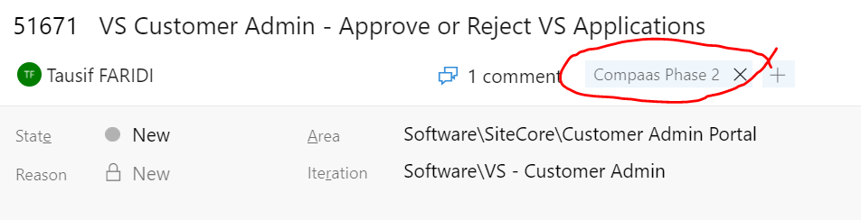
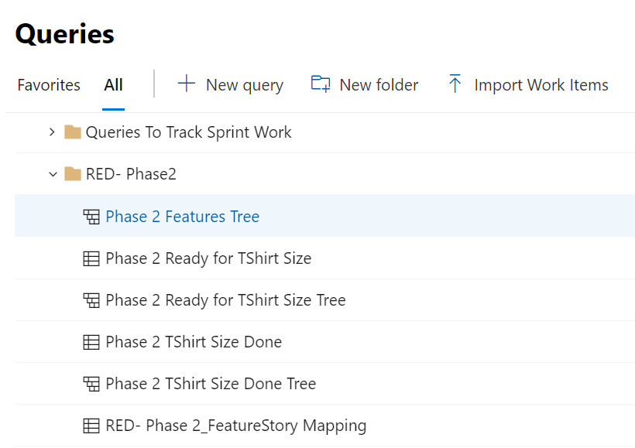
How to use tags in ADO
A “Tag” is a free text field that can be used to tag some text against a given Feature or User Story
For all features that belong to Phase 2 of Redeployment project, we need to add the tag “Compaas Phase 2” in that feature
The naming convention for a tag must be always followed - “CompaasPhase2” is not the same as “Compaas Phase 2”, so proper spacing as per agreed convention must be followed
Care must be taken to not misspell the tag. For example, “Compass Phase 2” tag will not be treated same as “Compaas Phase 2” although they sound similar.
Any feature that needs to be moved out of Phase 2 will be tagged as “Compaas Phase 3” to ensure that the feature is still trackable but does not show up in the queries for Phase 2 features
A set of shared queries have been created to track Phase 2 features along with the epics in which they are placed. These queries can be found under folder “RED- Phase2”

Slide 50
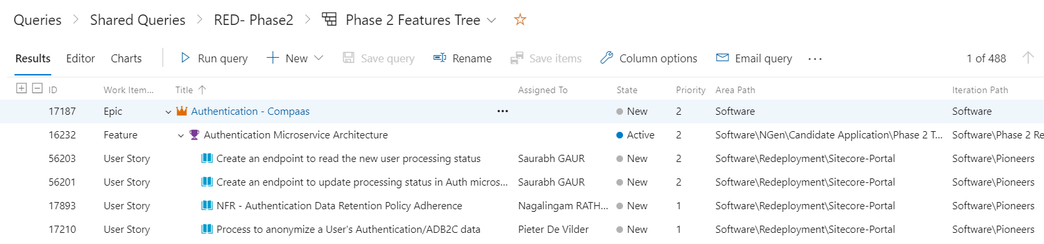



ADO Backlog Relationship
Epic: Highest level container in ADO. Equivalent to a module in the application. Can contain one or many features and user stories
Feature: Next level container in ADO. Equivalent to a single feature. Can contain one or many user stories
User Story: Smallest unit of functionality that can be implemented by code.

Slide 51
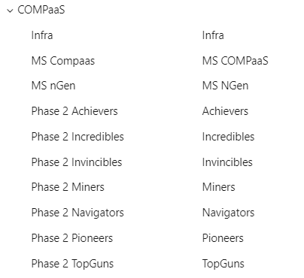
ADO Backlog Organization
Once the story is pushed from AHA to ADO then it is aligned to a Software Area and Actual/Dummy Iteration in ADO depending upon the mapped Area & Iteration path.
Area Path -> Areas in ADO allows us to group items by team which in turn will be working on specific platforms/applications like nGen/Candidate application. Once the paths are defined at the project level the SM’s will assign them to a team under the team configuration. A hierarchy of area to support sub areas can be created in area ADO and currently allows it to be 14 levels deep only.
For Career Mobility Phase 2 work it has been identified that teams will be aligned with the following 4 areas only
COMPaaS -> Teams which are working on COMPaaS side like Microservices implementation work etc.

Slide 52
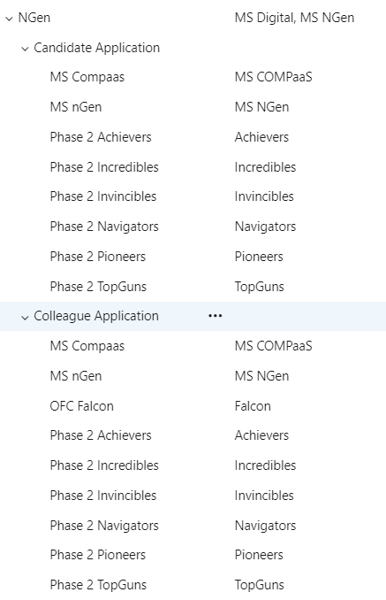
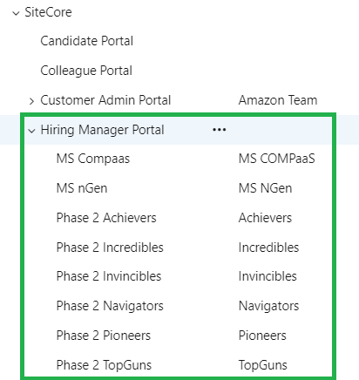
2) Ngen -> Teams which are working on Candidate and Colleague applications should be aligned with these areas.
Sitecore -> Teams which are working on HM portal enhancement work will be assigned that sub areas.

Slide 53
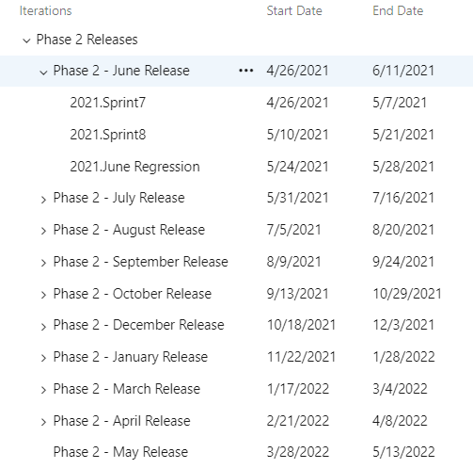
4) ETL Sync -> This is Miners team work area which is basically related to syncing of data between systems.
Iteration path -> Iteration path allows us to group stories and feature work items by sprint and releases respectively. Currently in phase 2 work all iterations are created under “Phase 2 Releases” item and each release comprises of 2 sprints and 1 week of regression.

Slide 54
Teams – AreaPath
Team | Platform/Application | Associated Area Path
Achievers | COMPaaS | Software\COMPaaS\Phase 2 Achievers
 | nGen - Candidate | Software\NGen\Candidate Application\Phase 2 Achievers
 | nGen - Colleague | Software\NGen\Colleague Application\Phase 2 Achievers
 | Sitecore | Software\SiteCore\Hiring Manager Portal\Phase 2 Achievers
Team | Platform/Application | Associated Area Path
Navigators | COMPaaS | Software\COMPaaS\Phase 2 Navigators
 | nGen - Candidate | Software\NGen\Candidate Application\Phase 2 Navigators
 | nGen - Colleague | Software\NGen\Colleague Application\Phase 2 Navigators
 | Sitecore | Software\SiteCore\Hiring Manager Portal\Phase 2 Navigators
Team | Platform/Application | Associated Area Path
Pioneers | COMPaaS | Software\COMPaaS\Phase 2 Pioneers
 | nGen - Candidate | Software\NGen\Candidate Application\Phase 2 Pioneers
 | nGen - Colleague | Software\NGen\Colleague Application\Phase 2 Pioneers
 | Sitecore | Software\SiteCore\Hiring Manager Portal\Phase 2 Pioneers
Team | Platform/Application | Associated Area Path
Incredibles | COMPaaS | Software\COMPaaS\Phase 2 Incredibles
 | nGen - Candidate | Software\NGen\Candidate Application\Phase 2 Incredibles
 | nGen - Colleague | Software\NGen\Colleague Application\Phase 2 Incredibles
 | Sitecore | Software\SiteCore\Hiring Manager Portal\Phase 2 Incredibles

Slide 55
Teams – AreaPath(Cont…)
Team | Platform/Application | Associated Area Path
TopGuns | COMPaaS | Software\COMPaaS\Phase 2 TopGuns
 | nGen - Candidate | Software\NGen\Candidate Application\Phase 2 TopGuns
 | nGen - Colleague | Software\NGen\Colleague Application\Phase 2 TopGuns
 | Sitecore | Software\SiteCore\Hiring Manager Portal\Phase 2 TopGuns
Team | Platform/Application | Associated Area Path
Invincibles | COMPaaS | Software\COMPaaS\Phase 2 Invincibles
 | nGen - Candidate | Software\NGen\Candidate Application\Phase 2 Invincibles
 | nGen - Colleague | Software\NGen\Colleague Application\Phase 2 Invincibles
 | Sitecore | Software\SiteCore\Hiring Manager Portal\Phase 2 Invincibles

Slide 56
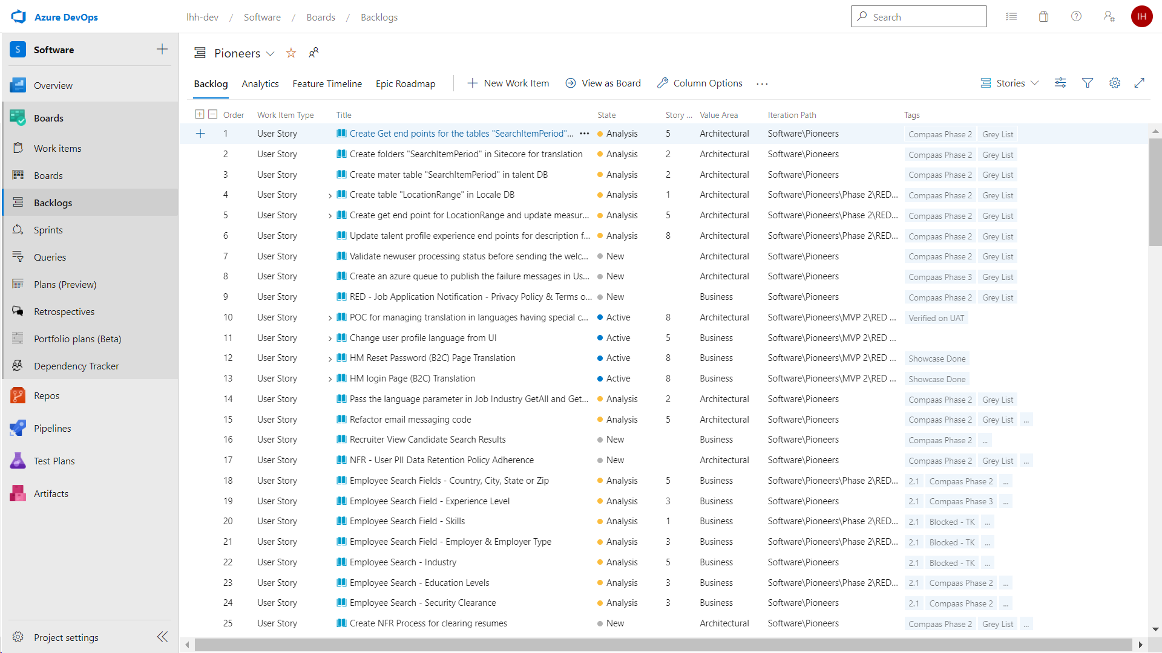
Team Backlog
In ADO we can check the entire backlog work allocated to a team under the backlog option.
Stories in ADO are organised under different views like a Backlog view to monitor the overall stories work assigned to a team, Sprint view to check sprint wise status of a team, additionally individuals can create their own private or shared queries for reporting purposes.
.

Slide 57
Feature and User Story Kanban
Guidelines and overall workflow here

Slide 58
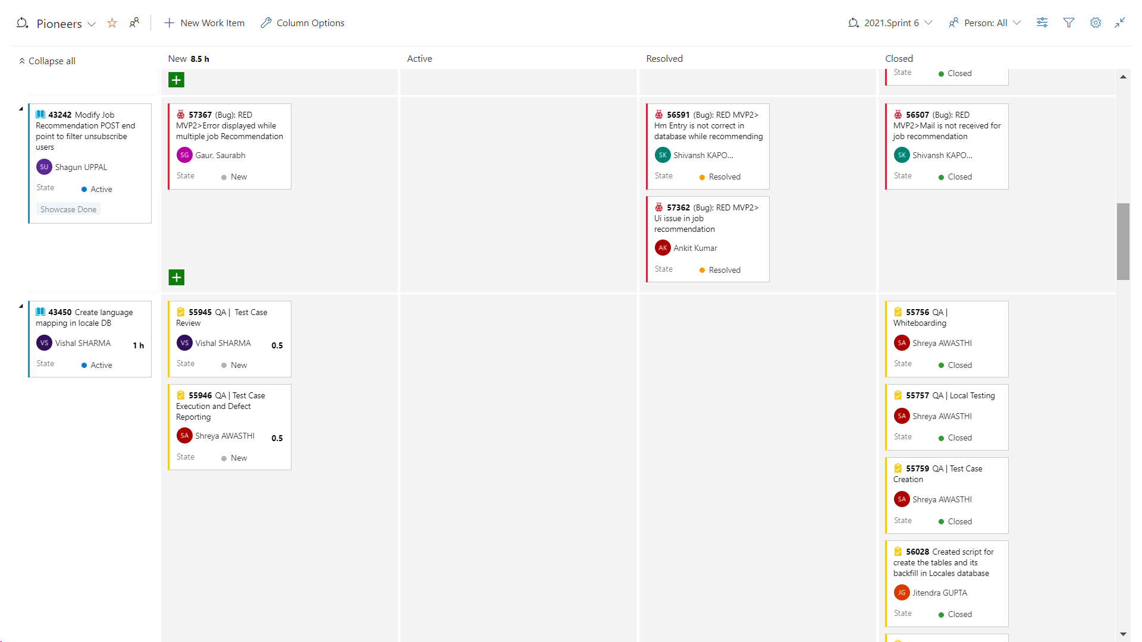
Team Sprint TaskBoard in ADO
For each team there is a sprint taskboard to monitor the progress of that sprint, this board outlines the state of all the tasks against a story. Once all the tasks within a story are closed then only the story is treated as complete.

Slide 59
ADO features
Dashboard

Slide 60
ADO features
Planner

Slide 61
ADO features
Queries

Slide 62
Roles and Responsibilities
5

Slide 63
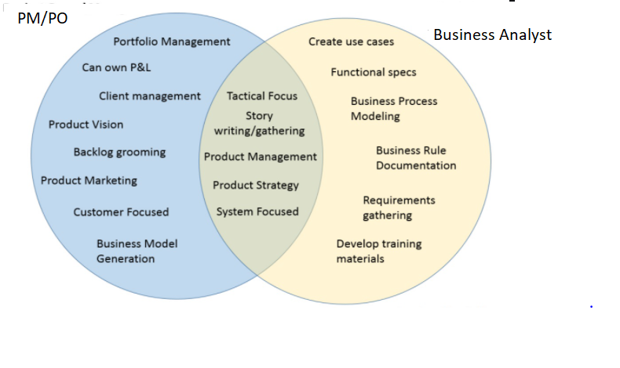
Product Owner and BA Role Defined
PO:
Owns the product
Define the features of the product based on product strategy & Product vision and Product roadmap
Be responsible for the profitability of the product (ROI)-
Prioritize features according to business value
Adjust features and priority every iteration, as & when needed
Accept or reject work results.
UAT

Slide 64
Career Mobility Program – Organization
Career Mobility Program Phase 2 Kickoff
Career Mobility Business Workstream Phase 2 Kickoff

Slide 65
Coforge Team Members: Roles and Responsibilities
# | Role | Names | Responsibilities
1 | Scrum Master | Islam Haider Manind Goel Rishal Jha Harpreet Kaur | Do daily stand-ups calls with team. Keep a close look into ADO backlog and monitor that no new stories are added on the fly. Keep a track of additional scope of work against the baseline scope. Should only create new stories in ADO. Work on creating WSR Raise risk around development readiness for upcoming sprint if not enough refined stories are available for development. Monitor and follow a close change control mechanism to ensure if any new work is added to the existing scope then same story points worth of work should be deprioritized. Ensure that refinement calls are happening on time. Ensure that 2 showcases per sprint are happening. Retrospective meetings are happening per release. Ensure that all stories are committed on the first day of sprint and a mail containing the scope of current sprint should be sent to the respective stake holders. Ensure that all the functional stories are assigned to respective BA’s before the start of UAT week. Ensure that release notes/rollout document is created for a release and pass on to release manager before production deployment. Follow-up on translation management. Raise risk at the right time in order to avoid any blockers during development phase.
2 | Enterprise Architect | Vivek Sharma | Solutioning, Reviewing NFRs; getting approvals on solutions from ARB / Adecco. Helping evaluate and induct tech stack productivity tools. Reviewing microservices architecture and technical backlogs related to architecture adherence. Working with NFR owners Pieter De Vilder, Greg Crease and others to refine NFRs, create solutions and guide implementation. Communicating and reviewing architecture with Adecco architects / ARB members on on-going basis. Reviewing performance and working with NFR architect.
3 | System Architect | Sundeep Tyagi Mukesh Arora | Backlog refinement and implementation design. Guiding scrum team on implementation and reviewing code / design.
4 | Architect (NFR) | Vimal Prakash | Documenting NFR requirements in ADO as stories. Guiding and reviewing NFRs with scrum teams (implementation), QA teams (outcome control), NFR owners (Acceptance criteria).
5 | Architect (Data) | Abhishek Gupta | Implementing design and architecture as per Enterprise data architecture. Working with QA to ensure NFR and arch adherence. Bringing in DB product specific capability – POSTGres (connection pooling, PaaS scaling, backups, design optimization) Understanding and producing reports from Data Lake / mart / microstrategy/ any other sources

Slide 66
Coforge Team Members: Roles and Responsibilities (cont)
# | Role | Names | Responsibilities
6 | Architect (Infra) | Abhay Mishra | Capacity planning and Sizing of PaaS / other services to align to NFRs. Designing infra for NFRs like geo-localization. Implementing environments and guiding devops teams on IaaC / declarative models like terraform.
7 | Business Analyst | Preetam Singh Shashank Gupta Sumi Raina Madana Keshabatla | Initial analysis of product needs – From Product and Delivery team’s perspectives Convert Needs into Stories with Epics, Features and Requirements Detailed Review Story Progression with Product and Business Managers Submit Stories for Peer & Product Manager Review Submit Stories for Technical Review and refinement Participate in UAT
8 | Onsite Solution Architect | Subhash Dutta | Coordinating and working with TextKernel architects and dev teams. Creating migration plan from DM1 to DM2 and doing feasibility analysis of the same. Helping scrum teams resolving dependencies on TK team. Coordinating project plans across LHH, scrum teams and TK.
9 | PM | Imran Jah | Planning Aligning technical, business and scrum teams on project objective Dissemination of key information to Coforge team Participation in calls with LHH to participate in overall planning process Creation of User Story readiness plan Creation of high level and detailed execution plan Resource planning for Scrum teams Monitoring & Control Tracking deliverables against execution plan Tracking project metrics to ensure smooth execution and course correction if required Identification and mitigation plan for risks during execution Reporting and governance for Scrum deliverables Participate in Change Control Board to monitor changes in Baseline Scope and Effort and assess its impact on the delivery timelines, effort and cost Liaising with LHH team Escalate to LHH Project Manager in case the external dependencies on LHH Business team, Adecco teams and 3rd parties (like Text Kernel, Bit Glass etc.) is not met on time Participate in the discussions (if needed) with Product Owners around Continuous prioritization of the Feature list Participation in daily/weekly governance calls Facilitate discussions with offshore teams on topics including but not limited to Scope changes, Functional clarification, Technical challenges Ensuring sign-off and approvals are received on deliverables

Slide 67
Scrum Team’s Learnings from Phase 1
SM's only add/remove stories in ADO.
Frequent discussions around release scope finalization and clear change control process in place.
Risk/Decision register is maintained and diligently followed in order to capture the CR’s.
All key Adecco and third party stakeholders should be part of project kick off and expectations on both sides and timelines to be discussed with them.
Every story including NFR’s should have an owner who will be adding the details & acceptance criteria to them.
Daily lead calls helped mitigate lots of issues upfront.
Predecessors/Successors links are setup in ADO for stories wherever required.
A new story without a parent is never created.
Combining Refinement calls with Technical and business clarifications helped save time for everyone.

Slide 68
Translation Process Management
Step 1
1.1 Developer to ensure that no translatable text is hardcoded.
1.2 SM’s to update the list of Resource Keys, Content Module & Sitecore Keys in David’s sheet available here before the start of a sprint.
Step 2
At the end of each sprint, regression week & UAT week, SM to validate that the number of new resource keys created as part of that sprint development is matching with the list of keys shared in the excel file above. Count can be matched with the help of below query. (Note: Any changes in translation found during regression/UAT will be accommodated in next release)
select * from ngen.dbo.resourcekey where DateAdded>='SprintStartDate'

Slide 69
Translation Process Management
Step 3
3.1 Once translations are received from the vendor, SM will make sure that resource key translations are updated in the DB/Sitecore for all the supporting languages.
3.2 SM to share nGen related resource keys with BizOps team in the excel template which can directly be uploaded through Admin option.
3.3 BizOps team to upload Sitecore related Resource Keys/Content Module in QA, UAT & PROD.
Step 4
All the translations should be uploaded in QA environment during regression week for 1st level validation where QA team will validate these translations on the front end by comparing them with excel file for at least 2 languages other than en-US.

Slide 70
Translation Process Management
Step 5
Once the 1st level signoff is received from QA team then all the translations should be uploaded by BizOps team in UAT environment before the start of UAT week for business user’s validation. SM will share the excel template file with BizOps team before that.
Step 6
If any new keys identified during or post sprint work then SM will make sure that it is updated in David’s sheet as well.
Step 7
All translations should be uploaded in Prod by BizOps team on the release day.
Note:- All the above steps should be created as tasks in stories with the respective owners.

Slide 71
Bug Life Cycle
Steps​ | TAGS​ | Owner​ | State​ | Bug Reason | Assigned to​ | Severity | Reopened Toggle | Root Cause | Area Path | Iteration Path
A new defect is created in ADO |  | Tester | New​ | New-Moved to Backlog | Scrum Master​ | Critical/High/Medium/Low |  | Unknown | Area path should be as per parent User Story Area Path | Current Sprint Path
Bug Assigned to respective developer by Scrum Master |  | Scrum Master | New​ | New-Moved to Backlog | Developer
If Developer needs more details on the defect |  | Developer | New​ | New-Need More Information | Tester
QA gives more details on the defect and assigned back to developer |  | Tester | New​ | New-Moved to Backlog | Developer
If defect logged is not valid |  | Tester | Removed | Removed - Not a Defect/Not Reproducible/By Design | Tester
Developer Accept the defect and start working to fixing |  | Developer | Active | Active-Approved | Developer
Developer fixed the defect and check-in the code after the local testing with QA |  | Developer | Resolved | Resolved-Fixed | Developer |  |  | Select root cause as per fixes done
Code changes has been deployed in QA environment |  | Developer | Resolved | Resolved-Fixed | Tester
Logged bug has dependency on another story and dependent story is yet to be developed/deployed | Blocked | Developer | Blocked | Blocked | Developer
Logged defect cannot be resolved in the current sprint cycle since the said feature/ function will be covered later | Deferred | Developer | Deferred | Deferred | Developer
QA verify the defect and if defect is not fixed |  | Tester | Active | Active - Not Fixed | Developer
QA verify the defect and add the tag "Verified in QA" if working fine | Verified in QA | Tester | Resolved | Resolved-Fixed |  |  | TRUE
QA finds the same defects surfaces again later in Testing | Re Opened | Tester | Re Opened | Active - Not Fixed | Scrum Master​
Once defect has been verified in UAT |  | Tester | Closed | Closed - Verified | Tester
Defect logged as an enhancement | New User Story Required | Tester | New​ | New-Moved to Backlog | Scrum Master​ |  |  | Inadequate Requirement
When new story is created against the enhancement defect |  | Tester | Removed | Removed - Enhancement | Tester

Slide 72
Thank You

